Slide 1
Central Coast Region Stormwater Control Measure Sizing Calculator
Introduction and Instructions
Version: 2/26/2014

Slide 2
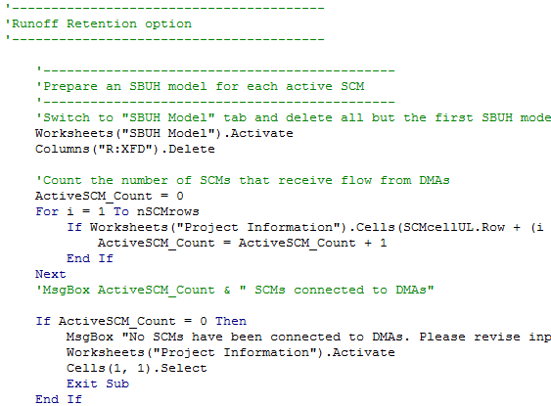
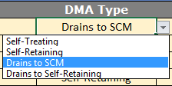
Software Features and Notes
Calculator is a MS Excel workbook with VBA code to guide data entry and hydraulic calculations
Allow “Macros” when opening
Worksheets are “protected” to prevent changes in format, row and column locations, etc., and to protect embedded equations
Cells are color-shaded to match their use: yellow = data entry blue = generated results grayed-out = not used
Combo box/drop down lists are used wherever possible to guide data entry values:

Slide 3
Software Features and Notes (Cont.)
Calculator contains four worksheets:
Project Information:
Project site, DMA, SCM characterization and results summary
SBUH Model:
Location where model calculations are performed
SCS, SBUH Equations:
Reference equations used by Calculator
Lookups, Constants:
Values used in drop down lists and equations
Core of the user interface: Described in detail over the next 7 slides
Background calculations:
Described in the final 3 slides

Slide 4
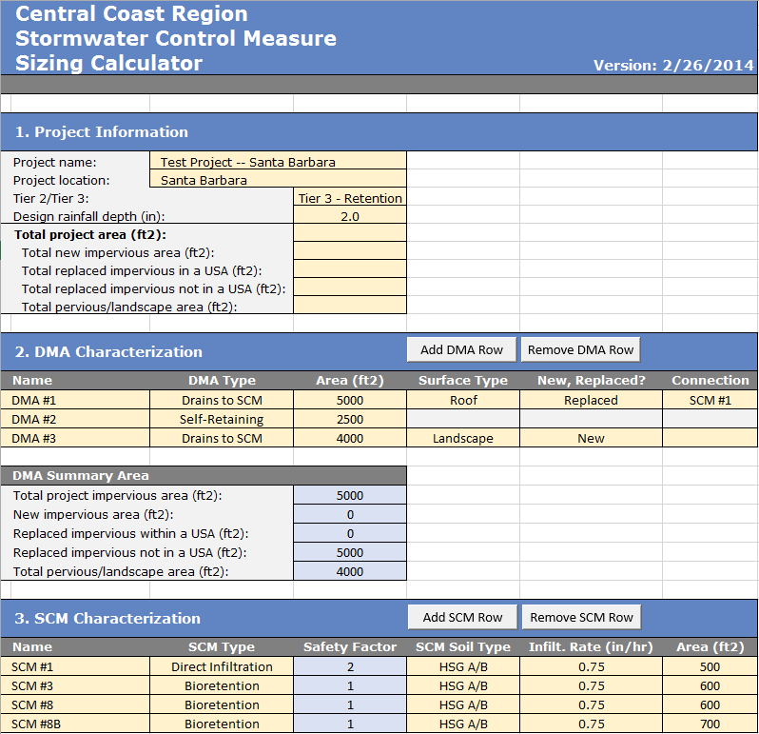
Project Information Worksheet Overview
Enter project site location and characteristics using drainage planning documents
Define Drainage Management Areas. Iteratively add/remove and modify their characteristics
Define Stormwater Control Measure characteristics. Iteratively test different configurations

Slide 5
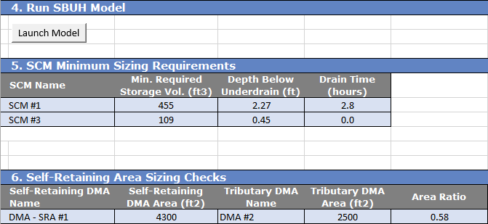
Project Information Overview (Cont.)
After DMAs and SCMs are defined, click to launch sizing calculations
Calculator runs SBUH model and provides min. volume, depth and drainage time for each SCM
Calculator tracks connections and tributary area ratio for each Self-Retaining Area

Slide 6
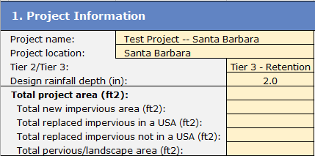
Project Information Table
Enter project name and location
Select: “Tier 2 – Treatment” or “Tier 3 – Retention”
Select design rainfall depth
Summarize from your drainage plan. Calculator will compare these values to the DMAs you enter later

Slide 7
DMA Characteristics Table
Add or remove DMAs here: not by manually inserting/deleting rows
Provide descriptive name
Select:
1) Self-Treating
2) Self-Retaining
3) Drains to SCM
4) Drains to Self-Retaining
Enter DMA Area
Select:
1) Roof
2) Concrete/asphalt
3) Grouted unit pavers
4) Pervious concrete
5) Porous asphalt
6) Unit pavers in sand
7) Open/porous pavers
8) Crushed aggregate
9) Turfblock
10) Landscape
For impervious areas, select:
1) New
2) Replaced
3) Replaced in an Urban Sustainability Area
Select DMA connection for “Drains to SCM” and “Drains to Self-Retaining” DMA types:

Slide 8
DMA Characteristics Table (Cont.)
Calculator summarizes DMA impervious and pervious area types
Compare the results to the values entered in the “Project Information” table

Slide 9
SCM Characteristics Table
Add or remove SCMs here: not by manually inserting/deleting rows
Provide descriptive name
Select:
1) Direct Infiltration
2) Bioretention
Safely factor is computed
Select:
1) HSG A/B
2) HSG C/D
3) Site-specific
Reads selection on the left:
A/B = 0.75 in/hr
C/D = 0.25 in/hr
Site-specific = user-provided
Enter SCM plan area
Notes:
You will need to enter SCMs here before you can “connect” DMAs to them
You can iteratively modify SCM characteristics to test design concepts and fine tune your design

Slide 10
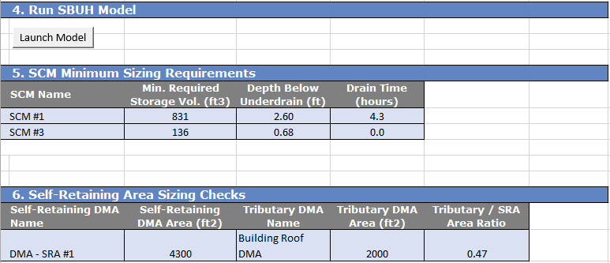
Launching Calculations and Viewing Results
Click here after you have entered/updated all DMAs and SCMs. Software runs SBUH model for each connected SCM.
Model results/minimum sizing is reported here. Note: Drain Time = 0 means the bioretention is dry before the 24 storm has ended (exfiltration > inflow)
Self-Retaining Area tributary connections are reported here. If the Tributary Area Ratio > 2 the cells turns red.

Slide 11
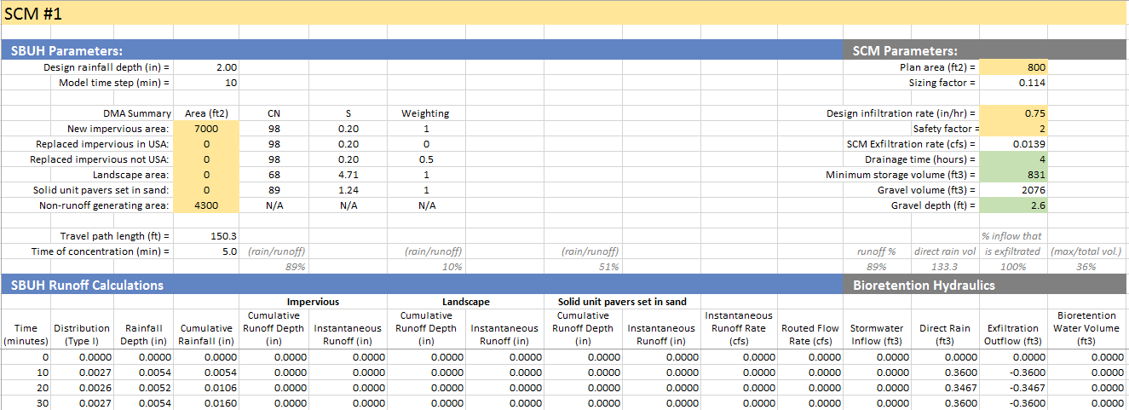
SBUH Model Worksheet
Yellow-shaded cells are copied from “Project Information” sheet
Blue-shaded cells contains results that are copied to the “Project Information” sheet
SBUH runoff and routing calculations. Equations are visible to the user
Bioretention hydraulic calculations

Slide 12
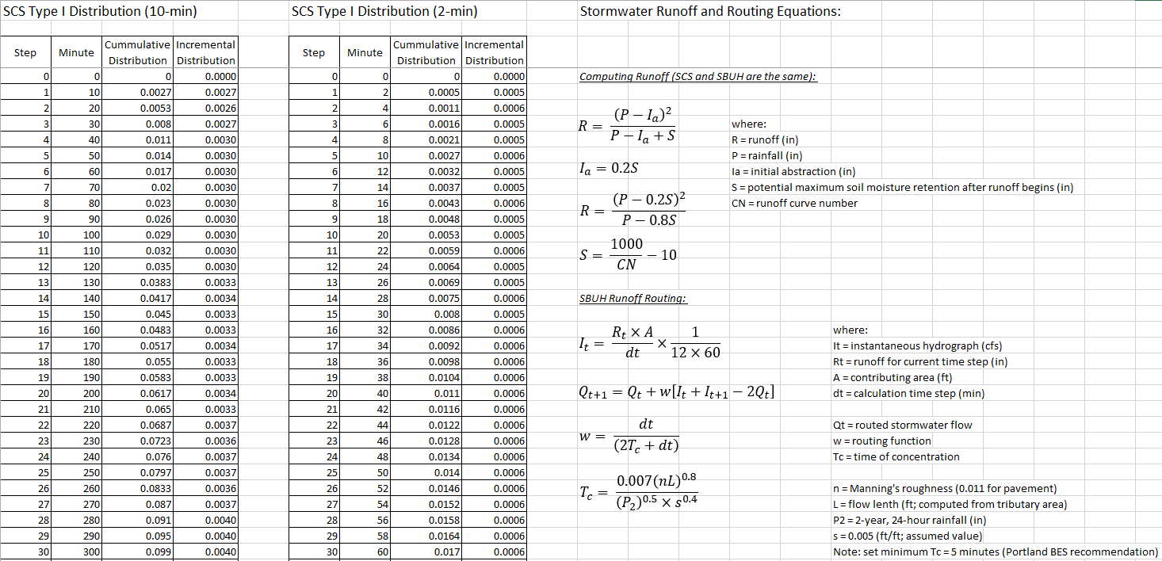
SCS, SBUH Equations Worksheet
Documents SCS rainfall distribution and equations used in hydrologic and hydraulic calculations

Slide 13
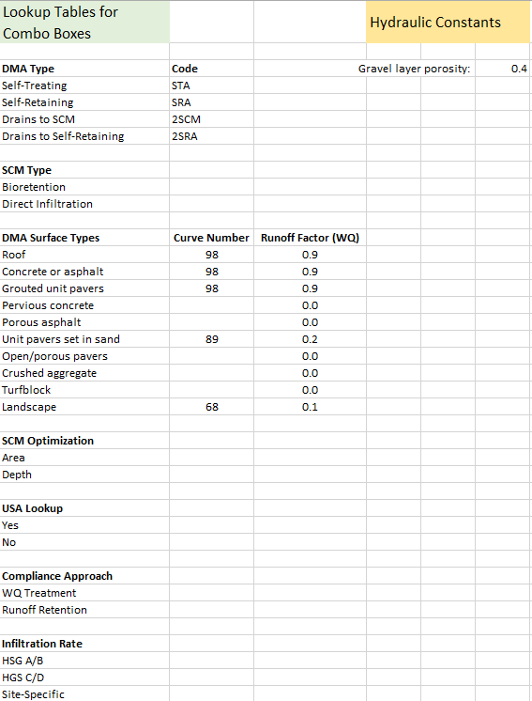
Lookups, Constants Worksheet
Contains lists of values used by combo boxes and constants used by SBUH model

