Slide 1
Public Safety Committee
Report of Crime Statistics and Police Activities
(January 1- December 31, 2021)

Slide 2
CRIME STATISTICS
2021

Slide 3
Work Volume: annual Calls for Service decreased by 5% annual Arrests and Citations decreased by 5%

Slide 4
Calls for Service by priority Jan-dec, 2021
Priority Level Descriptions
0, 1, or 2: First Priority; physical safety of person in jeopardy, i.e. fights, robbery
3: Second Priority; criminal activity in regards to property (non‐violent), i.e. in progress vehicle theft
4, 5, or 6: Third Priority; not typically criminal activity i.e. traffic problems, suspicious persons
7, 8, or 9: Fourth Priority; informational in nature, i.e. loitering, loud music

Slide 5
Overall 45% annual increase in Violent Crime in 2021 after a dip in most crimes in 2020

Slide 6
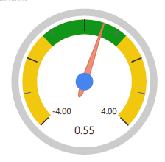
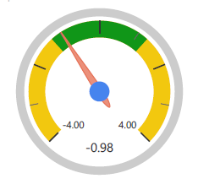
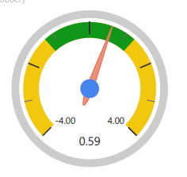
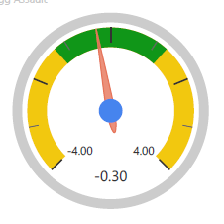
Violent crime Z-Score analysis for 2021
Homicide
Rape
Robbery
Aggravated Assault

Slide 7
Violent crime Z-Score analysis for 2021

Slide 8
Overall 6% annual decrease in Property Crime in 2021
Notes:
FINAL

Slide 9
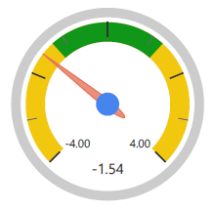
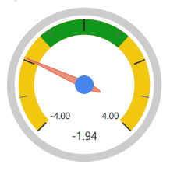
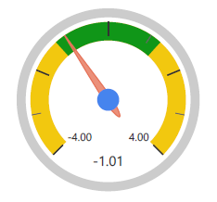
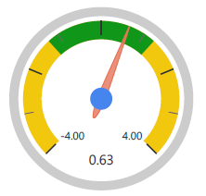
Property crime Z-Score analysis for 2021
Burglary
Larceny
Auto Theft
Arson

Slide 10
Property crime Z-Score analysis for 2021

Slide 11
Ten year crime snapshot
Date | Homicide | Rape | Robbery | Agg Assault | Burglary | Larceny | Auto Theft | Arson
1/1/2012 | 3 | 33 | 83 | 313 | 527 | 2792 | 264 | 21
1/1/2013 | 4 | 33 | 82 | 278 | 546 | 2481 | 215 | 20
1/1/2014 | 1 | 63 | 109 | 351 | 420 | 2602 | 250 | 23
1/1/2015 | 2 | 44 | 116 | 337 | 431 | 2732 | 300 | 23
1/1/2016 | 4 | 45 | 106 | 366 | 354 | 2874 | 382 | 10
1/1/2017 | 1 | 57 | 103 | 248 | 412 | 2911 | 362 | 30
1/1/2018 | 2 | 34 | 66 | 289 | 336 | 2308 | 261 | 53
1/1/2019 | 0 | 27 | 84 | 285 | 365 | 2430 | 227 | 37
1/1/2020 | 3 | 31 | 76 | 207 | 265 | 1732 | 234 | 46
1/1/2021 | 3 | 28 | 102 | 282 | 246 | 1617 | 214 | 38
Notes:
2021 is the lowest set of larceny and burgs, 2020 being 1732 and 2021 being 1617.

Slide 12
Nuisance Crime Trends From January – December, 2021, we saw a 27% annual decrease in Nuisance Crime arrests and citations.
Notes:
DRAFT – waiting on FY2021 bike theft numbers

Slide 13
Police department activities
2021Summary

Slide 14
Staffing update
Budgets Sworn Staff Positions | 94
Vacancies | 3
Field Training | 2
Police Academy | 17
Injured/On Leave | 9
Total Available | 63

Slide 15
Internal affairs
Formal Investigations | 2018 | 2019 | 2020 | 2021
 | 12 | 11 | 13 | 14
New in 2021:
External Investigators Utilized for Cases
New External Audit - Report Forthcoming

Slide 16
Bearcat activities – January-December 2021
Notes:
Details in attached report.

Slide 17
Other 2021 police initiatives
Launch SCPD Nextdoor Platform (February)
Dignity Health partnered with SCPD to provide officers with early COVID vaccines (February)
Three children were selected as honorary “Chief for the Day” (June)
Fix-It Ticket Sign Off Event (July)
BLM Vandalism Community Briefing (July)
Operation Sit the Bench, multi-agency response to criminal activities on the SL River. (August)
Westside Towing Operation (August)
Halloween Downtown Volunteer Trick or Treat Event (October)
Return of Traffic Enforcement (Motors) Unit (December)
Smash and Grab Prevention Evaluations (December)

