Slide 1
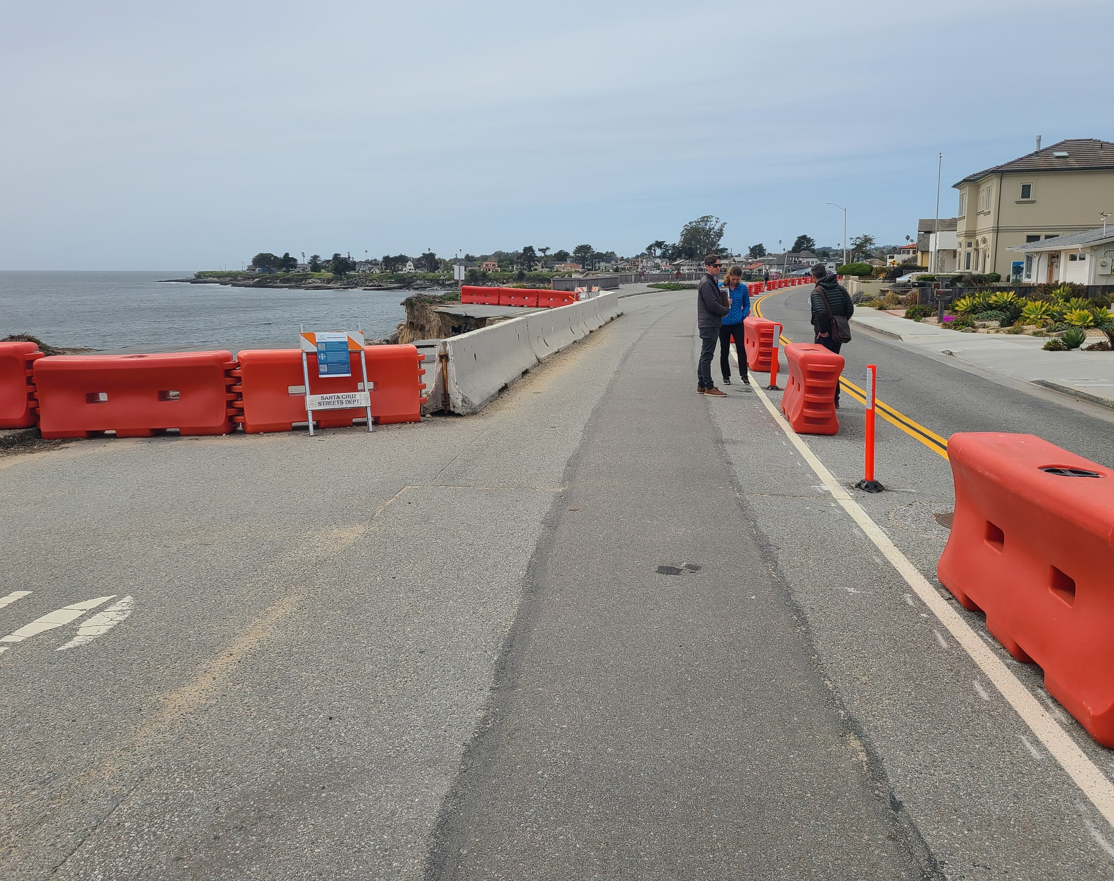
West Cliff Transportation
Update
TPWC
August 21, 20023

Slide 2
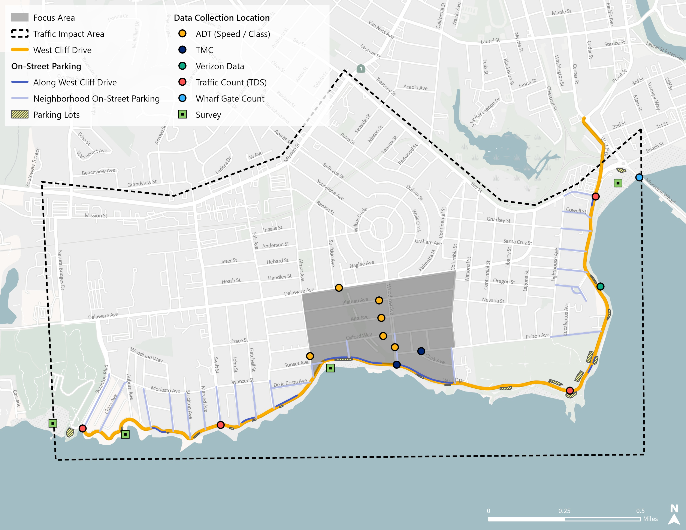
Available Data
ADT: Feb 2023 24-hour counts by 15min-interval on two days, 6 locations near west cliff drive, vehicle volume, speed and class
TMC: two intersections, same date as ADT count, AM and PM two-hour peak periods, modes are vehicle/bike/ped
Verizon
  parking at Cowells parking lot: events, duration, turnover rate, data from mid 2018 to sept 2022
  multimodal volumes at Pelton/West Cliff: modes are vehicle/bike/ped, data from April 2021 to sept 2022
Oxford closure last week of May

Slide 3
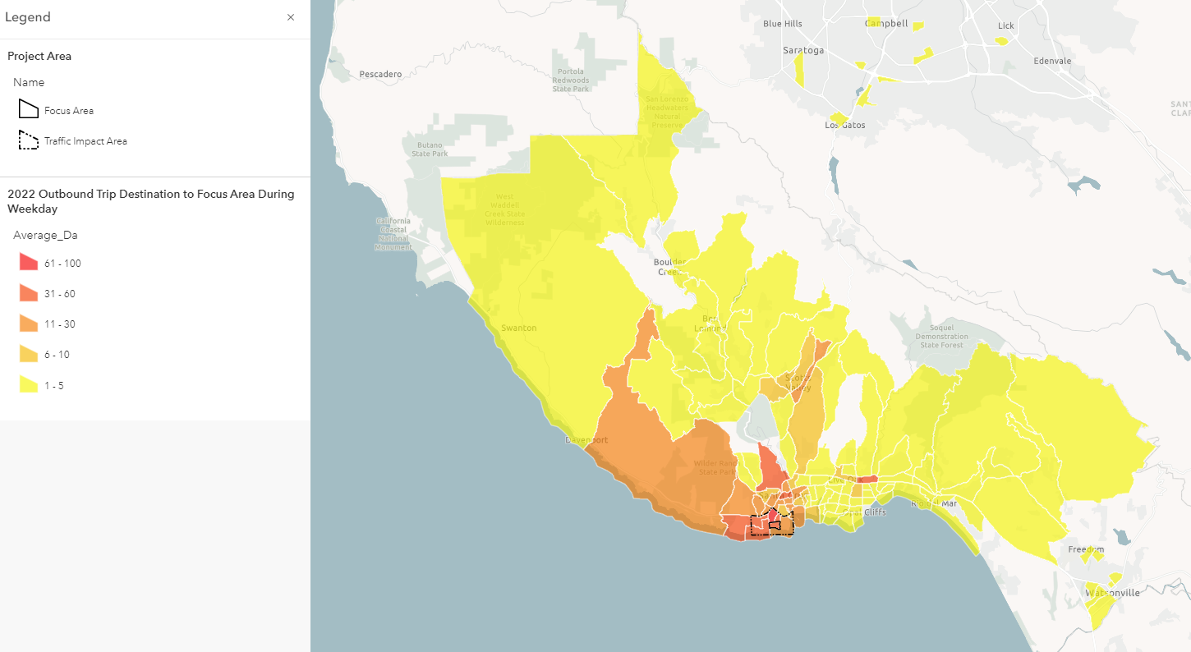

2022 Outbound Trip Destination
From Focus Area During Weekday

Slide 4
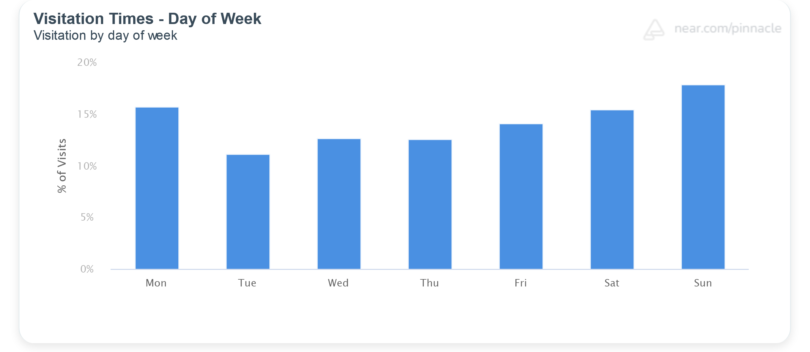
2023 Visitation Times – Day of Week

Slide 5
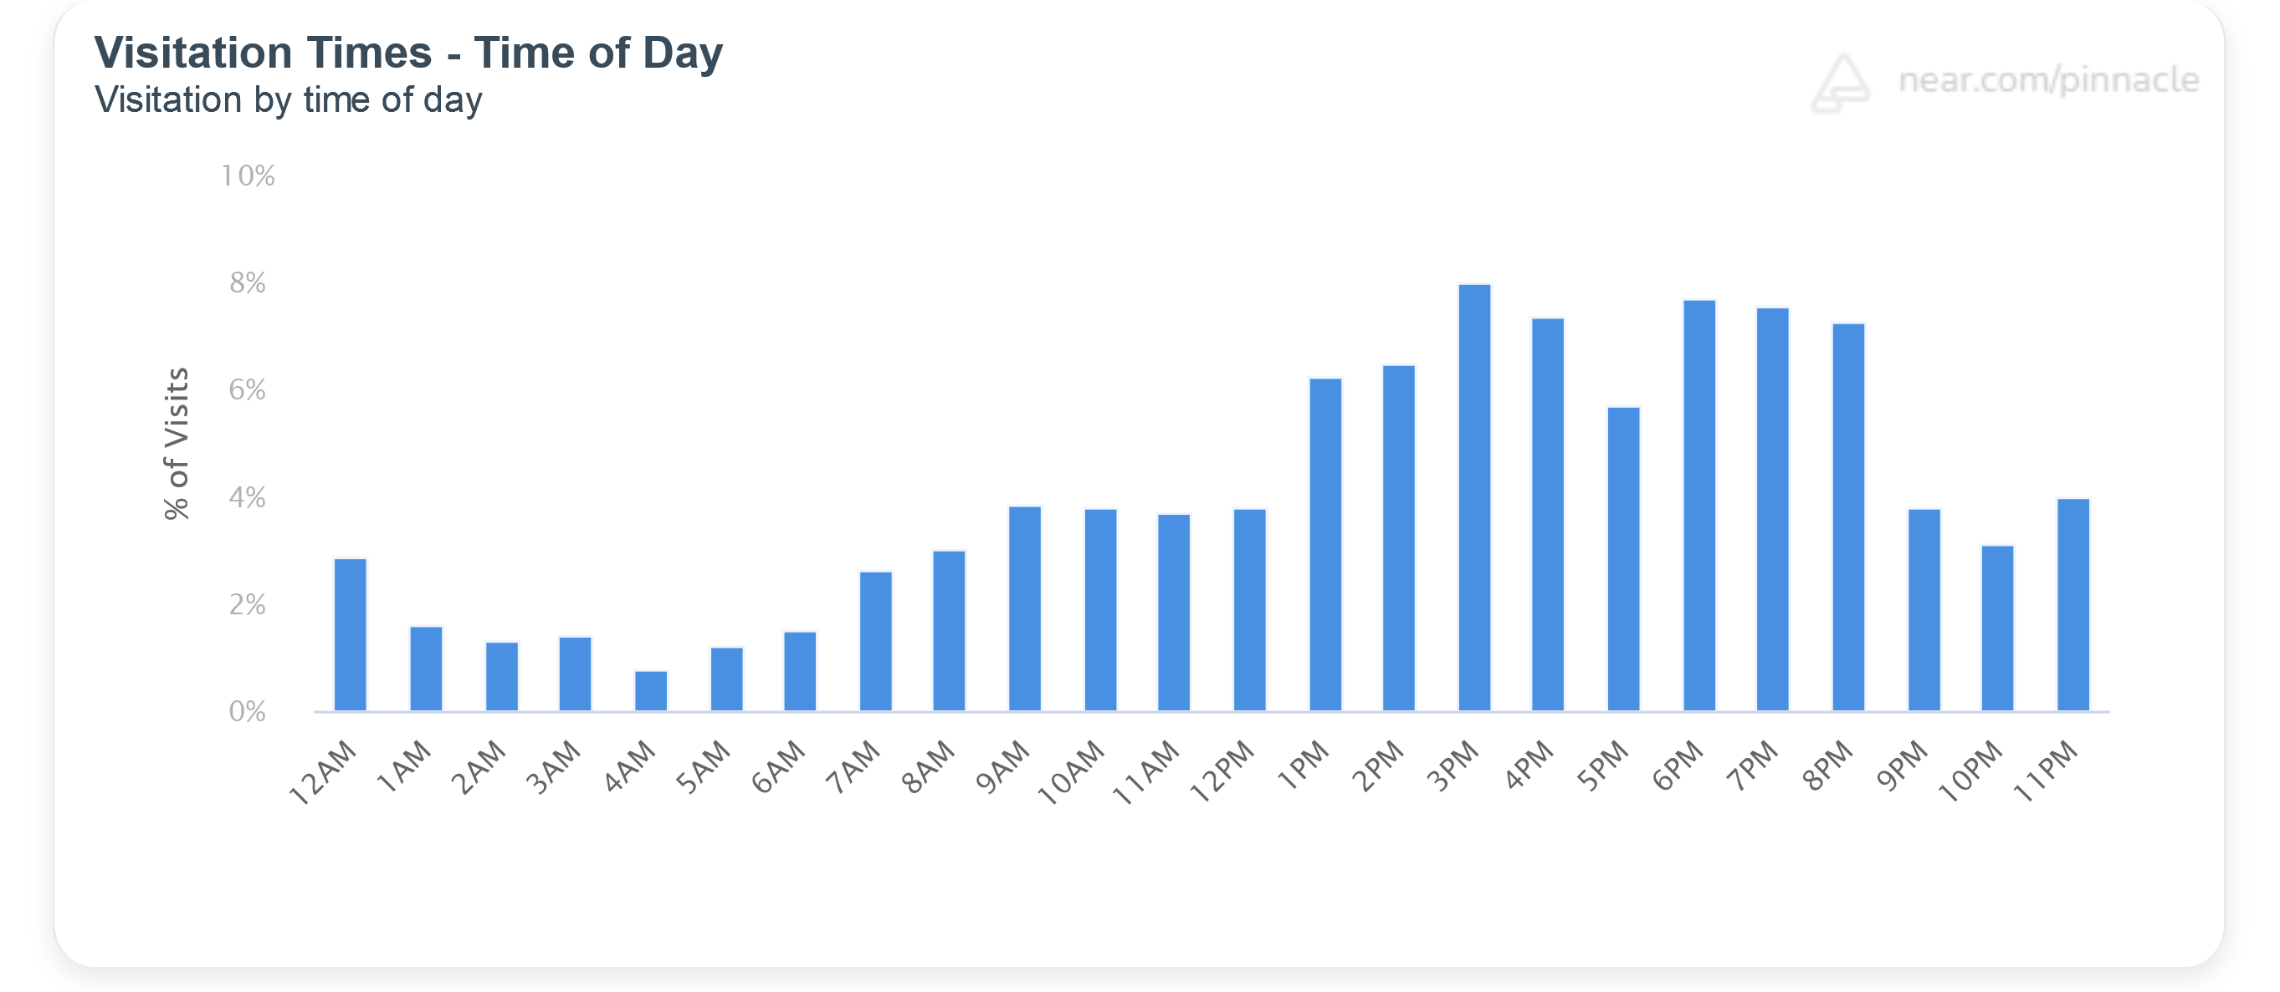
2023 Visitation Times – Time of Day
(all days)

Slide 6
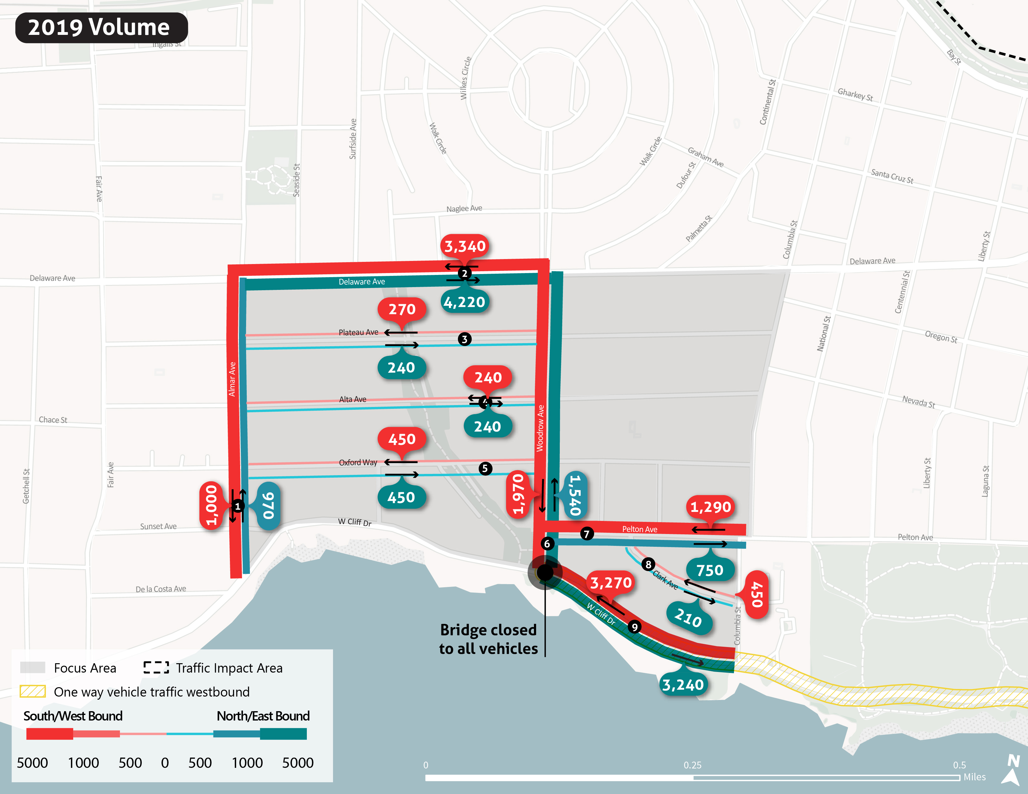

Slide 7
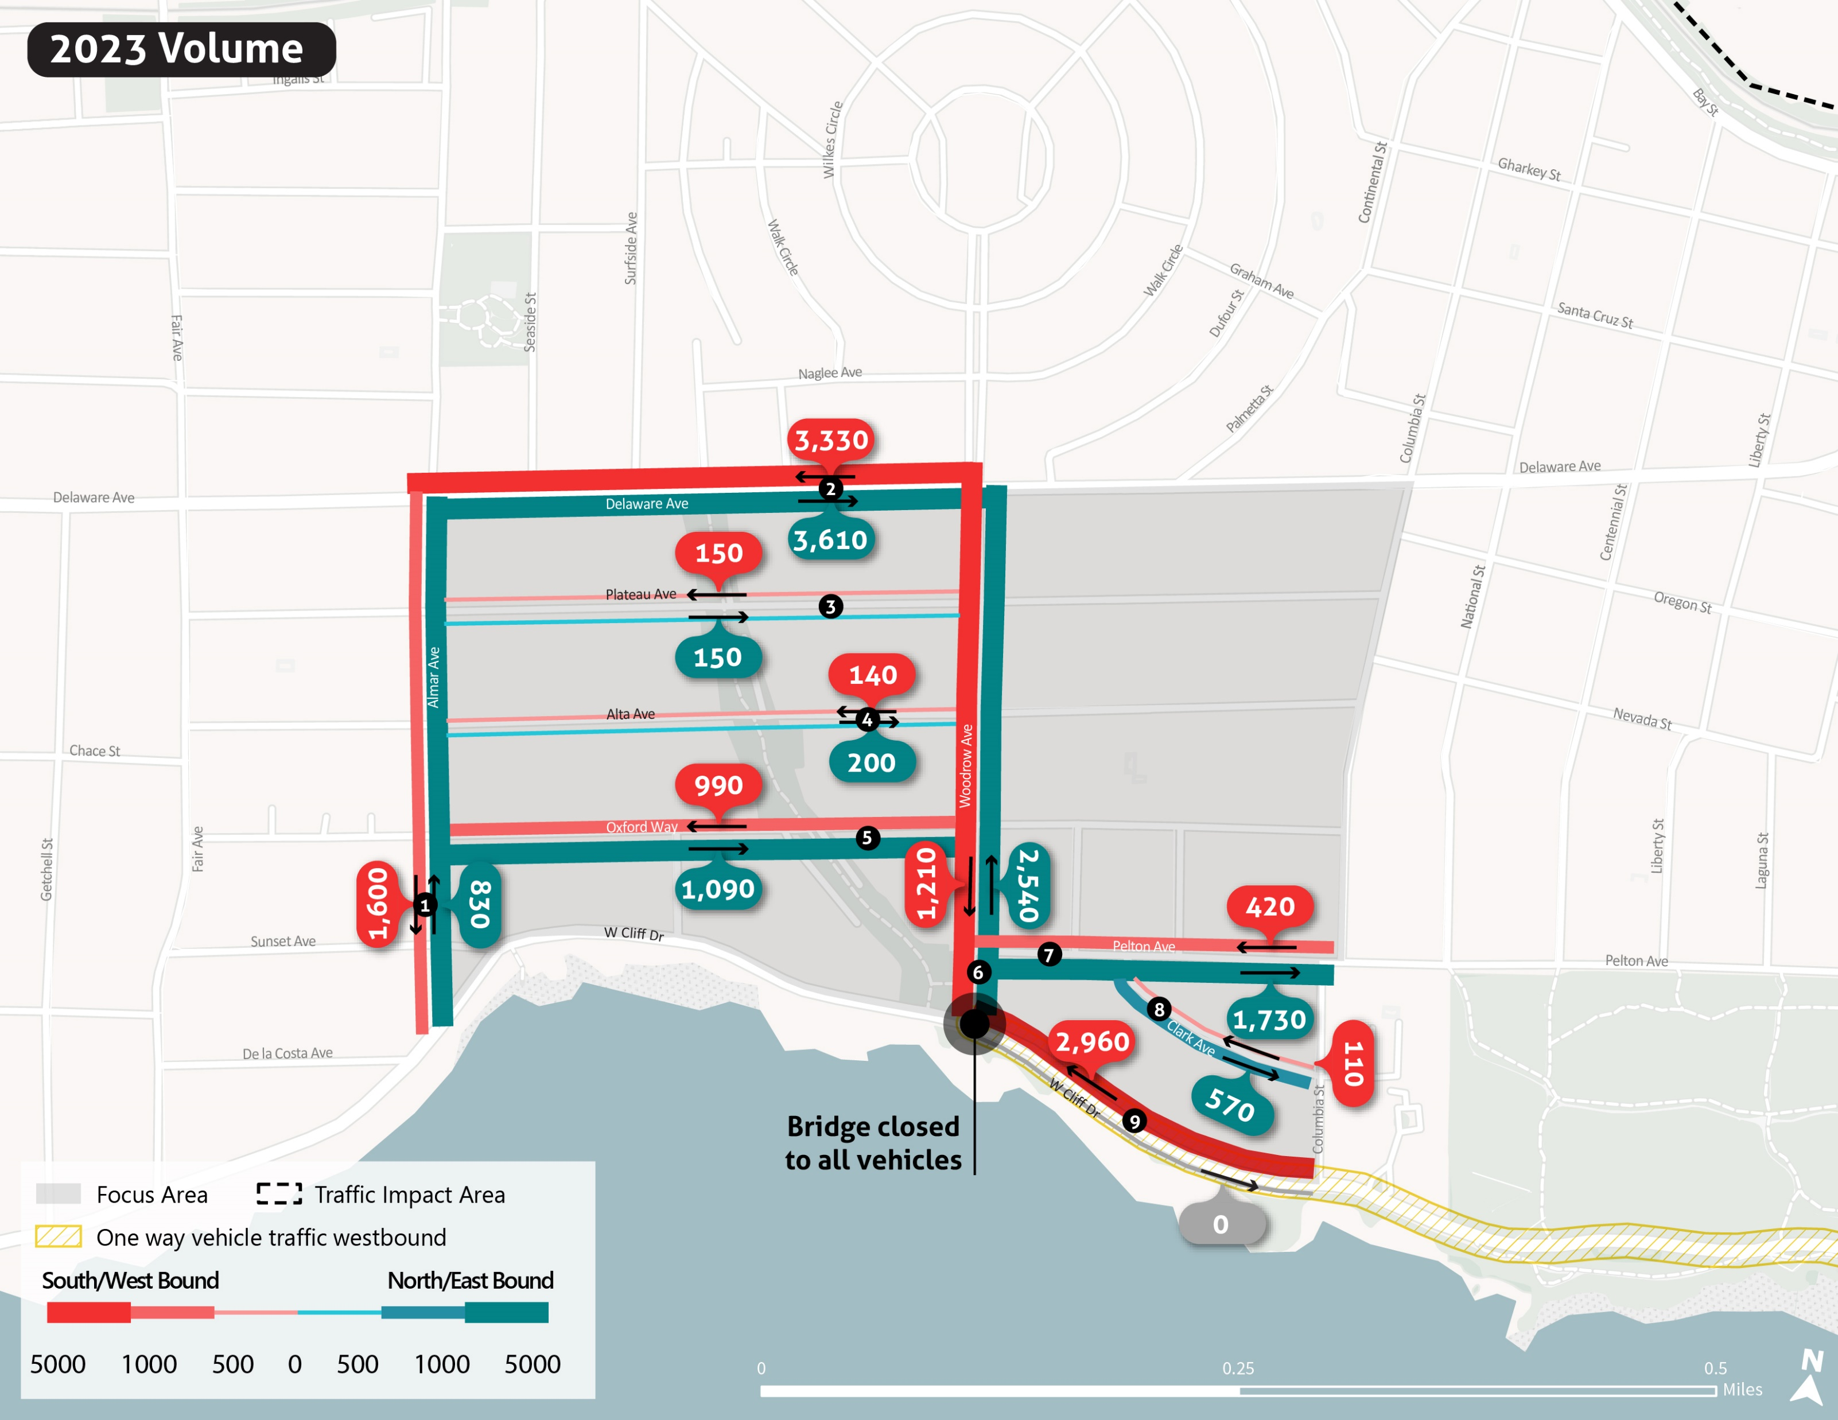

Slide 8
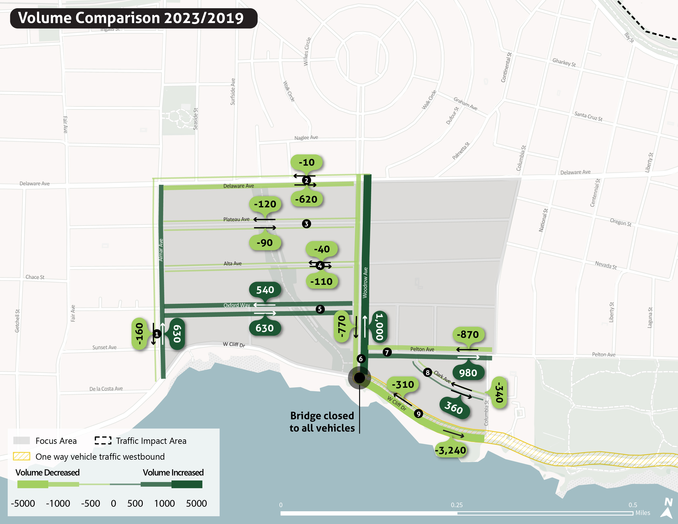

Slide 9
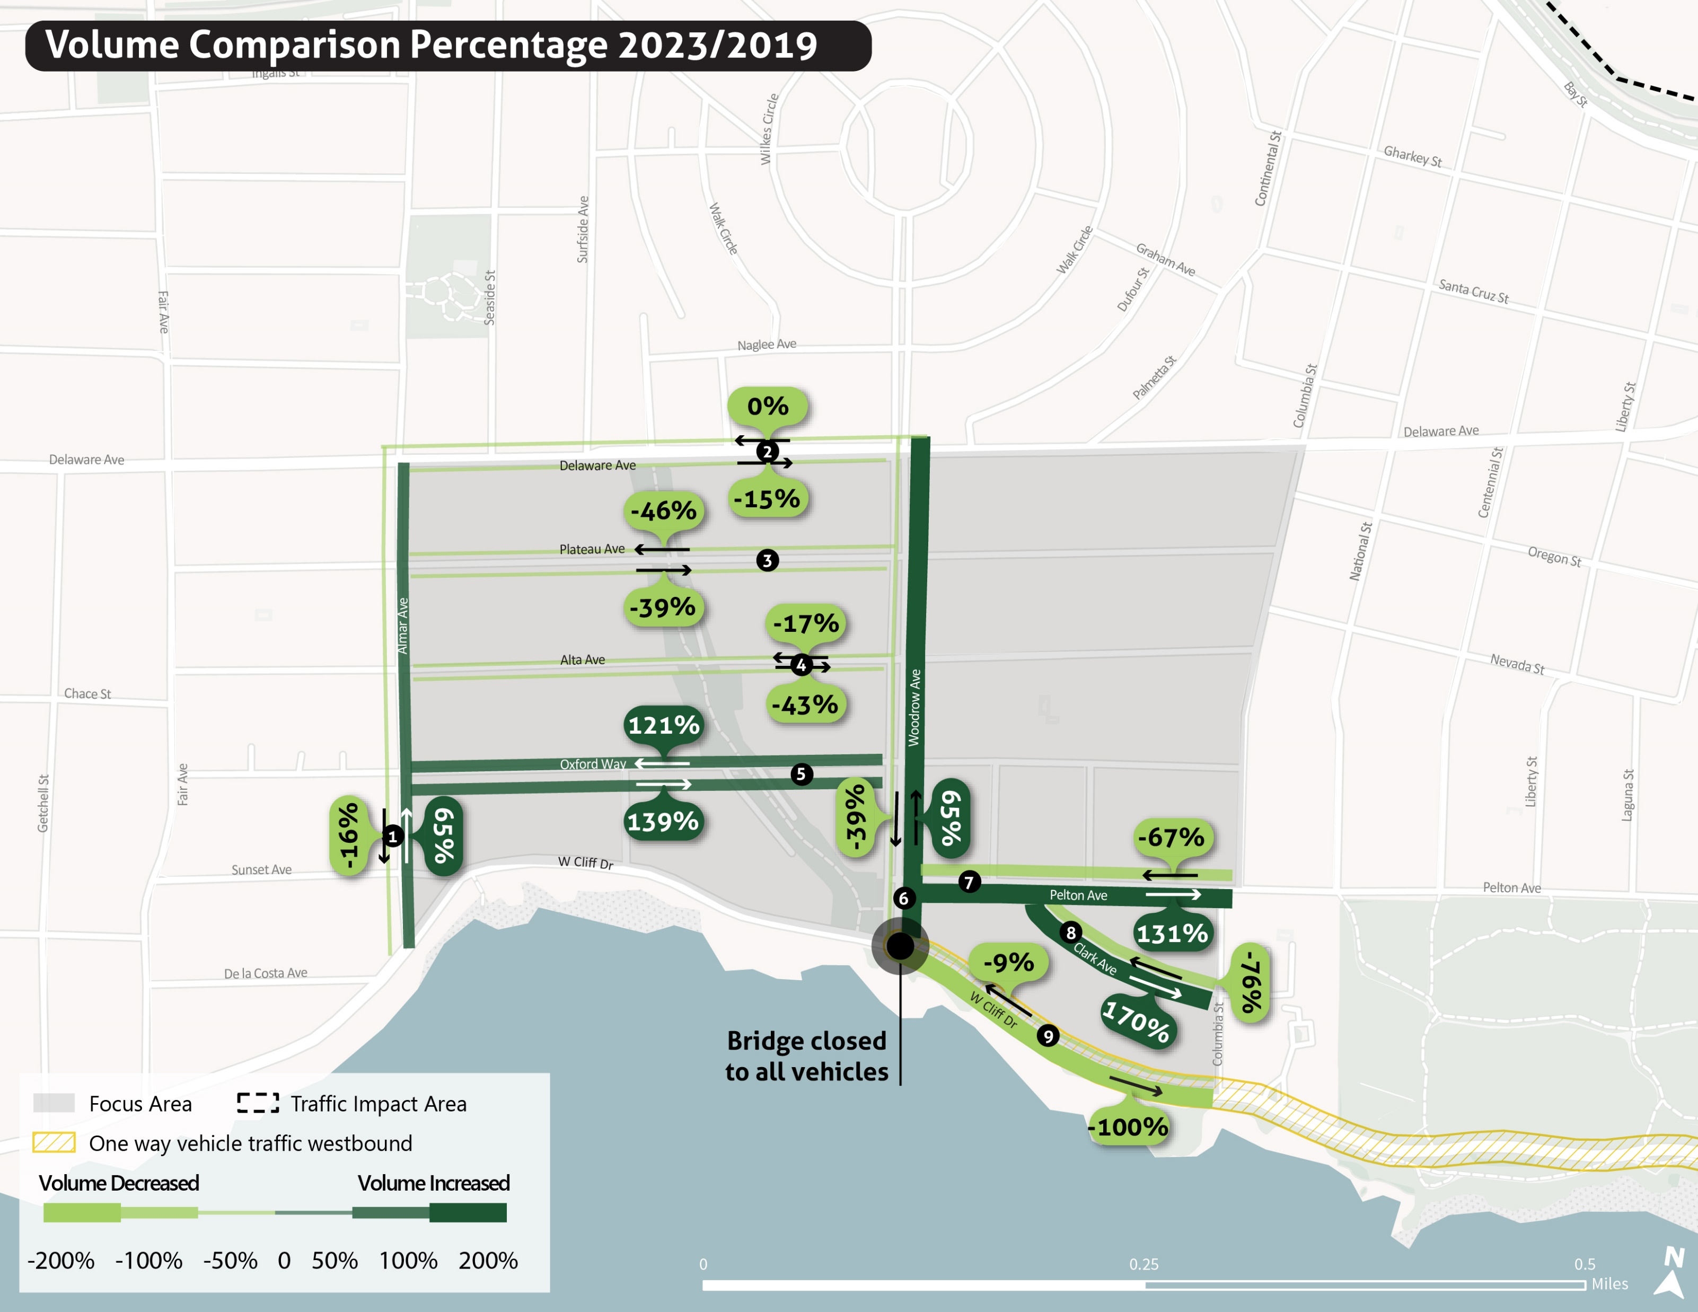

Slide 10
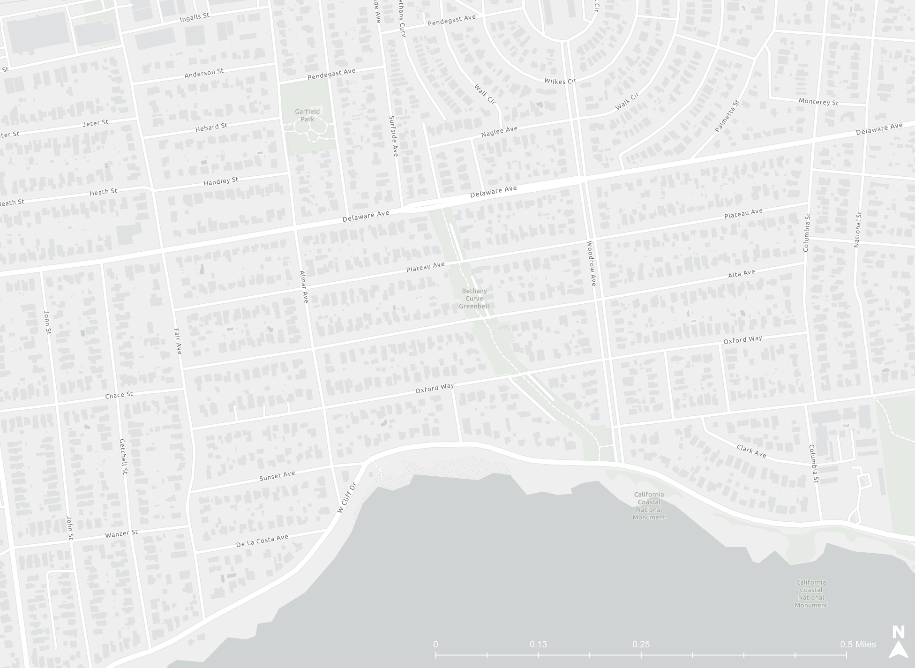
Alta Avenue: Greater number of vehicles traveling in westbound direction
Oxford Way: Greater number of vehicle traveling in eastbound direction.

Slide 11
Delaware Avenue and Plateau Avenue: Relatively even directional distribution of vehicle travel

Slide 12
Woodrow Avenue and Almar Avenue: Greater number of northbound vehicles due to detour routing

Slide 13
Active Mobility Volumes
Counts
Pre-Storm (2019) and Post-Storm (2023)

Slide 14
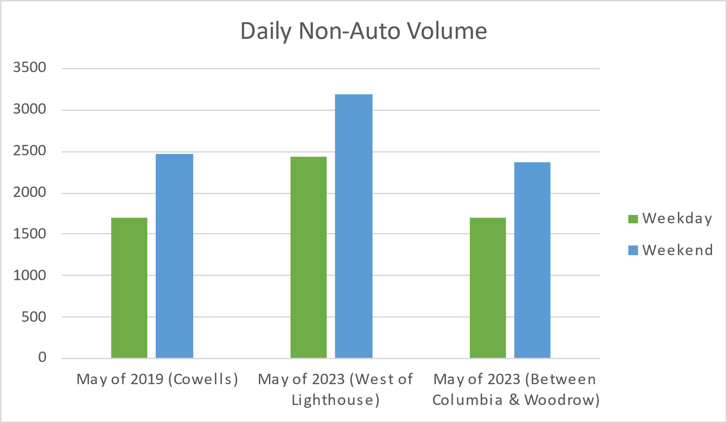

Slide 15
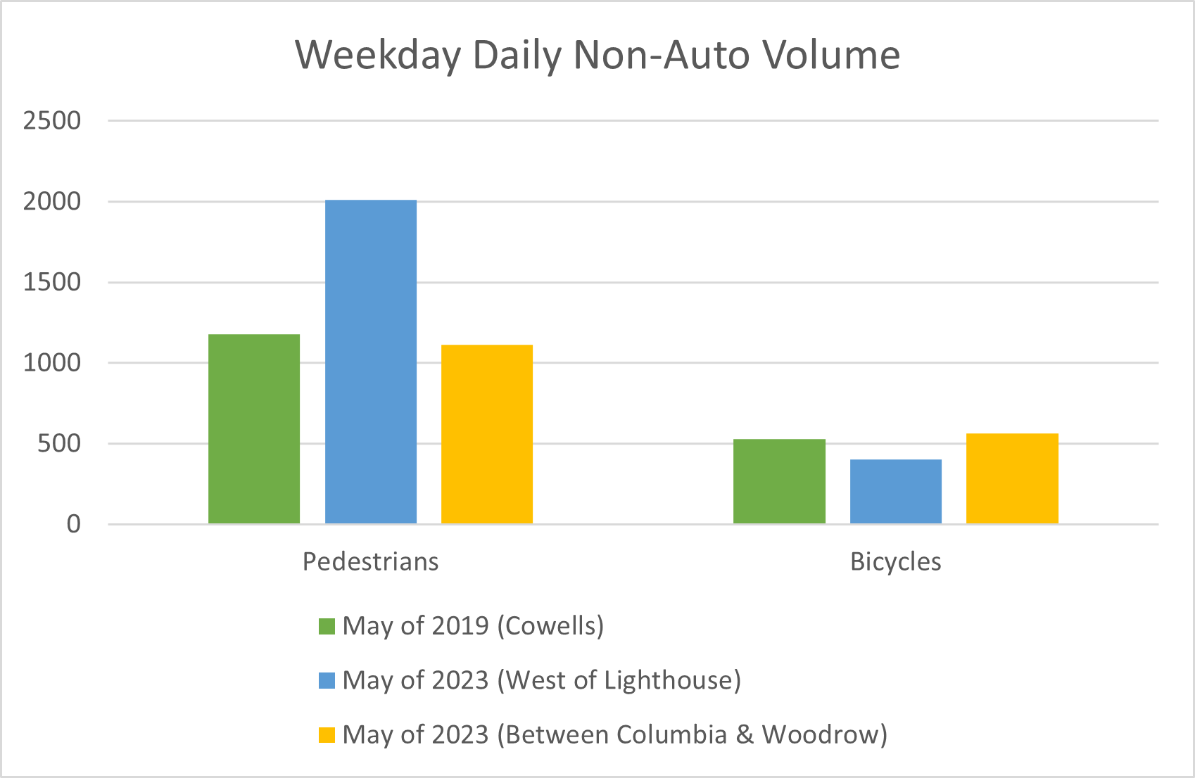

Slide 16
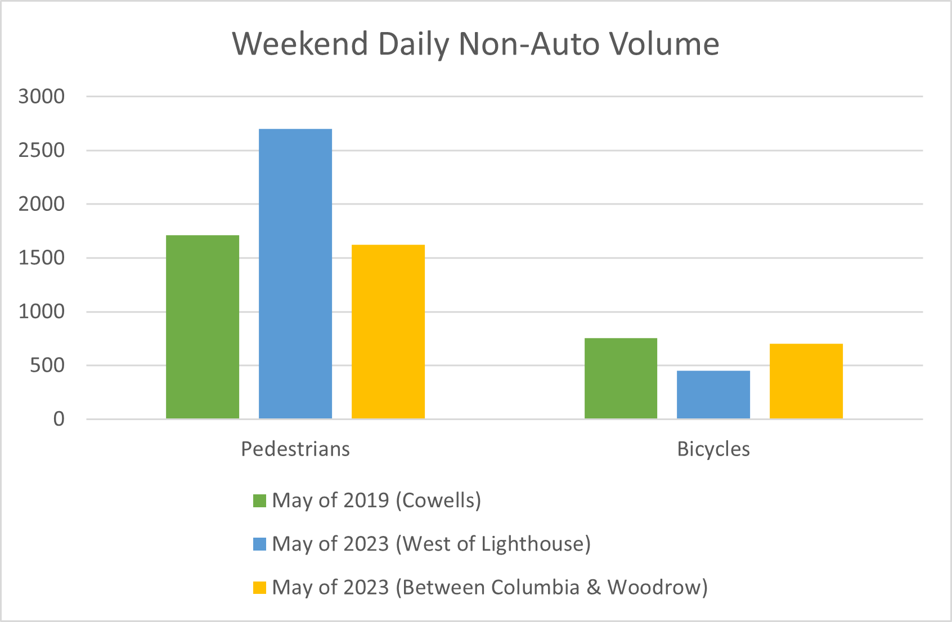

Slide 17
Findings
Traffic volumes on Delaware remain lower than 2019, with diverted volumes.
The bridge closure shifts some traffic into the neighborhood, but not all.
Overall study-area volumes are lower than in 2019.
Active transportation represents a large portion of travelers on West Cliff.

Slide 18
Thank you
For more information visit www.cityofsantacruz.com/westclifftrafficcontrols

